Slide 1

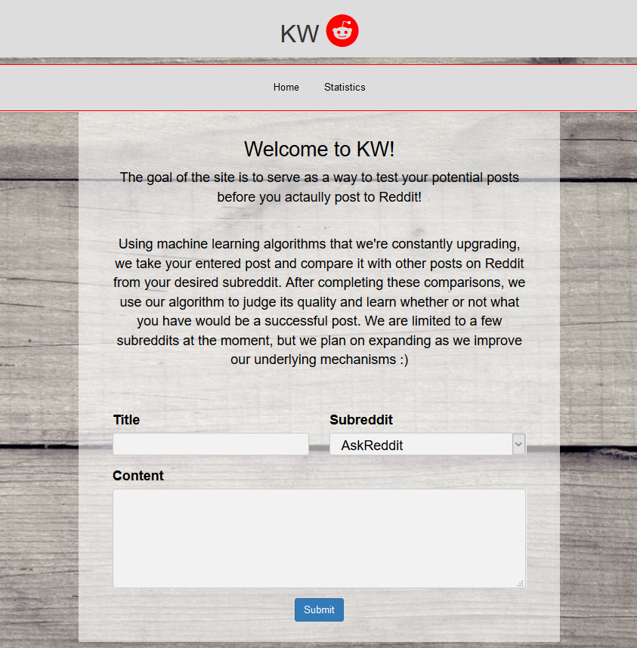
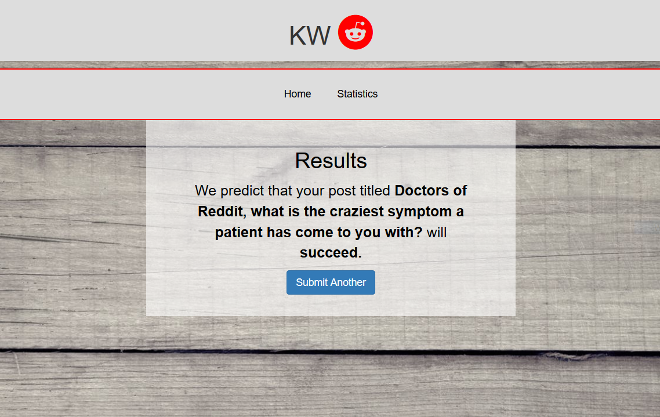
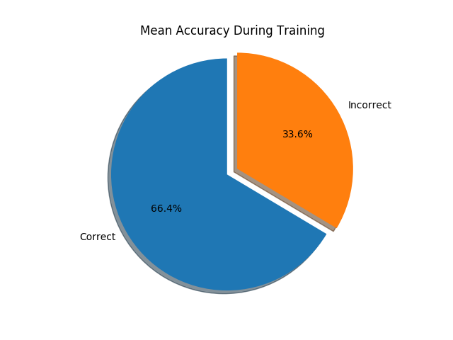
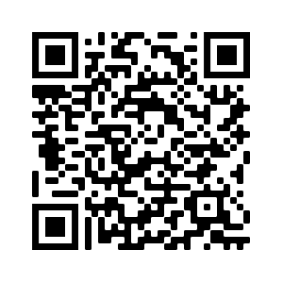
KW
Approaching Text Based Subreddits Through Machine Learning
Hagan Brewer, Joshua Brucker, Solomon Kim, Nelson Vargas
Abstract: A large part of Reddit's success as a "social news aggregation, web content rating, and discussion website" should be accredited to the implementation of karma as a powerful reward system that users can use to control what content is popular. Posts and inevitably users that gain large number of upvotes (a large karma score) are viewed with greater frequency and in higher regard respectively. Our team endeavors to build a machine learning system to grade the degree to which a new reddit post will be popular within a respective subreddit. Our team intends to quantify what makes a Reddit post successful and then give the users the opportunity to test their content before making their post public.
Figure 1: Home Page
Approach: Using a combination of naïve Bayes and logistic regression models, in combination with a data scrapper, a user enters their potential post’s content into our web app. Our algorithm then analyzes the highest and lowest rated posts over the last two years of Reddit post history to determine trends. The algorithm runs the user’s input through a process comparing the input to the results of the initial Reddit analysis. It then returns the likelihood of the user’s input to succeed or not succeed based on our definition of accumulating more than a designated karma threshold.
Figure 2: Results Page
Technologies:
Python
Bootstrap/HTML/CSS
Flask
Natural Language Processing
Features:
Title Analysis
Access to complete Reddit archive
Uses Real Time Data
Conclusion/Findings: Through this assignment, our team had the opportunity to delve into a realistic development setting. Using this assignment as an opportunity to learn machine learning, we faced many real world challenges such as learning new technologies, connecting technologies, and falling into technical debt. While we were able to learn a lot of the impressive hands-on capabilities of machine learning and natural language processing, we were also given the opportunity to experience and prepare for what life as a developer outside of college might truly be like.
Figure 3: Graph Representing Results
Future Work: We would like to expand our machine learning algorithms to include Images from visual subreddits such as r/Pics
Visit our Repo at https://github.com/csc4790-fall2019/sp-hagan-solomon-josh-nelson/wiki or Scan the QR Code
We would like to acknowledge the follow people/groups for their help: Dr. Benjamin Mitchell, Jason Dobies, the Villanova Computer Science Department

